Slide 1
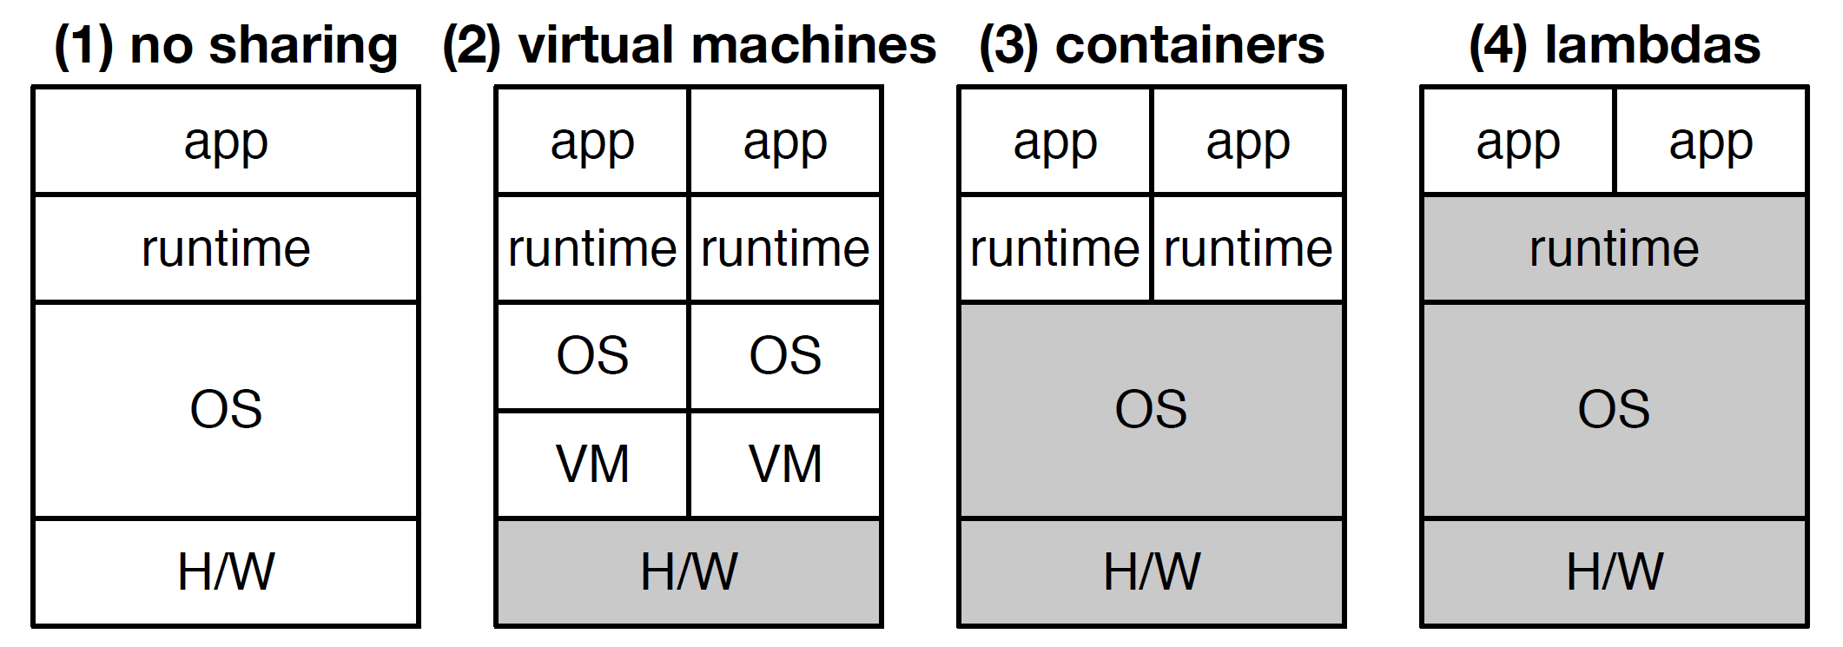
Lab 06 - Serverless Computing
https://bit.ly/B22245
https://bit.ly/B22244

